Slide 1
Azure basics

Slide 2
Azure Intro
Tenant,Management Group,Subscription
Region, Avaiability zones, resource groups
UAT,SIT,Prod,Dev
Types of services
  Compute – VM,ADF,databricks
  Storage – Storage accounts, DB, DWH,Datalakes,delta lake
  Virtual networks – Virtual networks
  ETL – adf
  Security – IAM,AD
  Datascience – Azure ML
  Devops – Azure Devops integrated with GIT

Slide 3
organizations and subscription
An organization represents a business entity that is using Microsoft cloud offerings, typically identified by one or more public Domain Name System (DNS) domain names, such as contoso.com. The organization is a container for subscriptions.
A subscription is an agreement with Microsoft to use one or more Microsoft cloud platforms or services, for which charges accrue based on either a per-user license fee or on cloud-based resource consumption.
  Microsoft's Software as a Service (SaaS)-based cloud offerings (Microsoft 365 and Dynamics 365) charge per-user license fees.
  Microsoft's Platform as a Service (PaaS) and Infrastructure as a Service (IaaS) cloud offerings (Azure) charge based on cloud resource consumption.

Slide 4
tenant
For SaaS cloud offerings, the tenant is the regional location that houses the servers providing cloud services. For example, the Contoso Corporation chose the European region to host its Microsoft 365, EMS, and Dynamics 365 subscriptions for the 15,000 workers in their Paris headquarters.
Azure PaaS services and virtual machine-based workloads hosted in Azure IaaS can have tenancy in any Azure datacenter across the world. You specify the Azure datacenter, known as the location, when you create the Azure PaaS app or service or element of an IaaS workload.
An Azure AD tenant is a specific instance of Azure AD containing accounts and groups. Paid or trial subscriptions of Microsoft 365 or Dynamics 365 include a free Azure AD tenant. This Azure AD tenant does not include other Azure services and is not the same as an Azure trial or paid subscription.

Slide 5
User accounts
User accounts for all of Microsoft's cloud offerings are stored in an Azure Active Directory (Azure AD) tenant, which contains user accounts and groups.

Slide 6
Summary of the hierarchy
Here is a quick recap:
An organization can have multiple subscriptions
  A subscription can have multiple licenses
  Licenses can be assigned to individual user accounts
  User accounts are stored in an Azure AD tenant
Here is an example of the relationship of organizations, subscriptions, licenses, and user accounts:
An organization identified by its public domain name.
  A Microsoft 365 E3 subscription with user licenses.
  A Microsoft 365 E5 subscription with user licenses.
  A Dynamics 365 subscription with user licenses.
  Multiple Azure subscriptions.
  The organization's user accounts in a common Azure AD tenant.

Slide 7
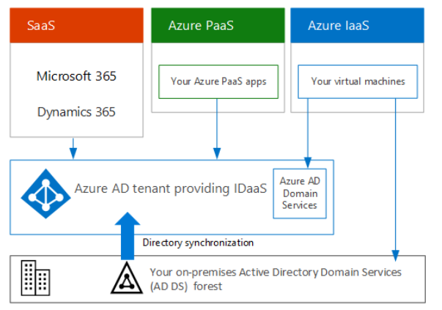
AD
Multiple Microsoft cloud offering subscriptions can use the same Azure AD tenant that acts as a common identity provider. A central Azure AD tenant that contains the synchronized accounts of your on-premises AD DS provides cloud-based Identity as a Service (IDaaS) for your organization.

Slide 8
Azure management groups
If your organization has many Azure subscriptions, you may need a way to efficiently manage access, policies, and compliance for those subscriptions. Management groups provide a governance scope above subscriptions. You organize subscriptions into management groups; the governance conditions you apply cascade by inheritance to all associated subscriptions.
Management groups give you enterprise-grade management at scale no matter what type of subscriptions you might have. However, all subscriptions within a single management group must trust the same Azure Active Directory (Azure AD) tenant.
For example, you can apply policies to a management group that limits the regions available for virtual machine (VM) creation. This policy would be applied to all nested management groups, subscriptions, and resources, and allow VM creation only in authorized regions.

Slide 9
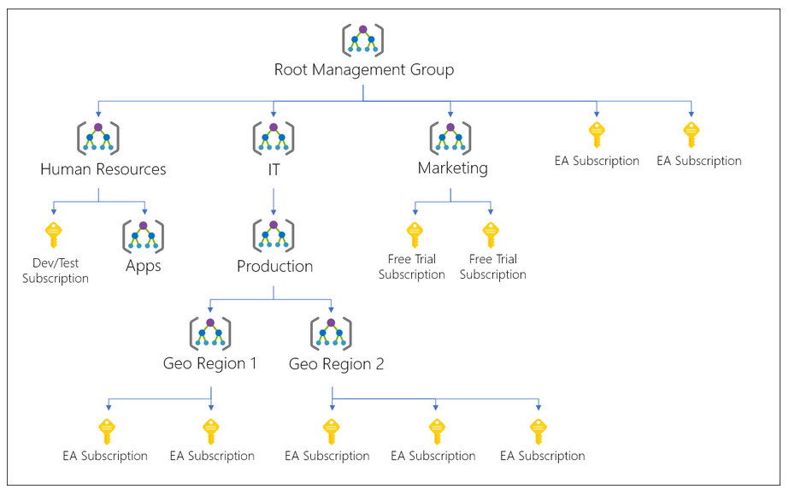
Hierarchy of management groups and subscriptions
You can build a flexible structure of management groups and subscriptions to organize your resources into a hierarchy for unified policy and access management. The following diagram shows an example of creating a hierarchy for governance using management groups

Slide 10
You can create a hierarchy that applies a policy, for example, which limits VM locations to the West US region in the management group called "Production". This policy will inherit onto all the Enterprise Agreement (EA) subscriptions that are descendants of that management group and will apply to all VMs under those subscriptions.
Another scenario where you would use management groups is to provide user access to multiple subscriptions. By moving multiple subscriptions under that management group, you can create one Azure role assignment on the management group, which will inherit that access to all the subscriptions. One assignment on the management group can enable users to have access to everything they need instead of scripting Azure RBAC over different subscriptions.

Slide 11
Root management group for each directory
Each directory is given a single top-level management group called the root management group. The root management group is built into the hierarchy to have all management groups and subscriptions fold up to it. This root management group allows for global policies and Azure role assignments to be applied at the directory level
The root management group can't be moved or deleted, unlike other management groups.
All subscriptions and management groups fold up to the one root management group within the directory.
  All resources in the directory fold up to the root management group for global management.
  New subscriptions are automatically defaulted to the root management group when created.
All Azure customers can see the root management group, but not all customers have access to manage that root management group.
  Everyone who has access to a subscription can see the context of where that subscription is in the hierarchy.
  No one is given default access to the root management group. Azure AD Global Administrators are the only users that can elevate themselves to gain access. Once they have access to the root management group, the global administrators can assign any Azure role to other users to manage it.

Slide 12
Regions and availability zones
Region:
  Each Azure region features datacenters deployed within a latency-defined perimeter. They're connected through a dedicated regional low-latency network. This design ensures that Azure services within any region offer the best possible performance and security.
Availability zones:
  Availability zone is composed of one or more datacenters equipped with independent power, cooling, and networking infrastructure.
  Azure availability zones are connected by a high-performance network with a round-trip latency of less than 2ms. They help your data stay synchronized and accessible when things go wrong.
  Availability zones are designed so that if one zone is affected, regional services, capacity, and high availability are supported by the remaining two zones.

Slide 13
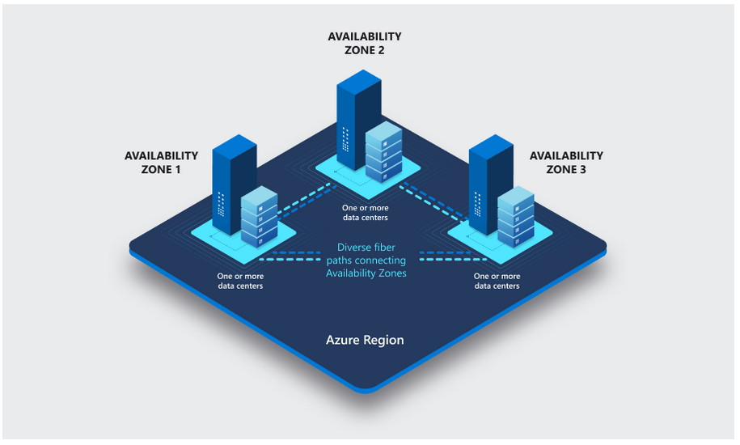
Availability zone
Failures can range from software and hardware failures to events such as earthquakes, floods, and fires. Tolerance to failures is achieved because of redundancy and logical isolation of Azure services. To ensure resiliency, a minimum of three separate availability zones are present in all availability zone-enabled regions.
Each data center is assigned to a physical zone. Physical zones are mapped to logical zones in your Azure subscription. Azure subscriptions are automatically assigned this mapping at the time a subscription is created.

Slide 14
Resource group
A resource group is a container that holds related resources for an Azure solution. The resource group can include all the resources for the solution, or only those resources that you want to manage as a group.
You decide how you want to allocate resources to resource groups based on what makes the most sense for your organization.
Generally, add resources that share the same lifecycle to the same resource group so you can easily deploy, update, and delete them as a group.
The resource group stores metadata about the resources. Therefore, when you specify a location for the resource group, you are specifying where that metadata is stored.
For compliance reasons, you may need to ensure that your data is stored in a particular region.

Slide 15
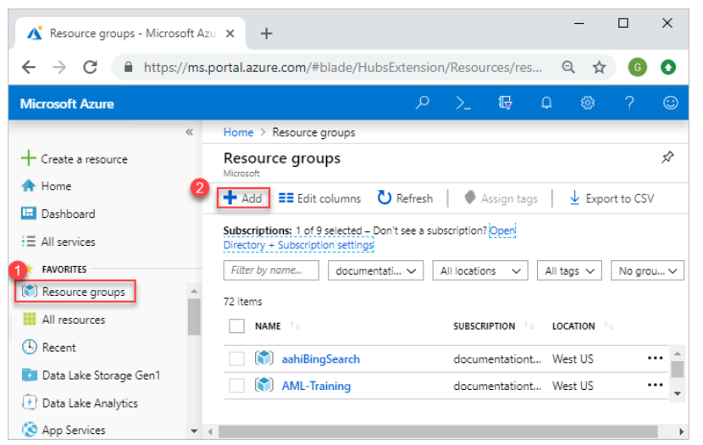
Create resource group
Open Azure portal
Search for ‘Resource group’ /select ‘resource group
Select “ADD”
Enter the following.
  Subscrition : your azure subscription from dropdown
  ResourceGroup: Enter a new resource group name
  Region : select desired region from the list of available regions

Slide 16
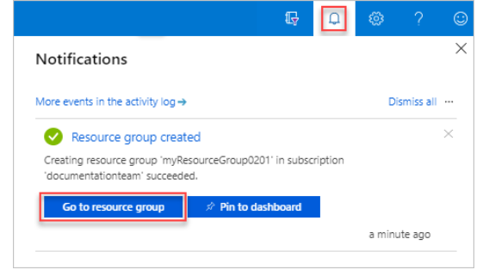
Create resource group
Select “Review + Create”
Select create. It takes some time to create resource group. The same can be seen in notifications.
Once you see “Green Tick mark”, your resource group is created
You can view the same by going back to list of resource groups.

